Slide 1
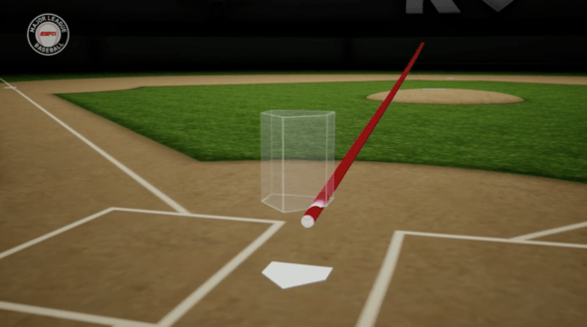
Baseball Pitcher’s Accuracy
Jordan Brooks, Anthony Rollin, David Hoke

Slide 2
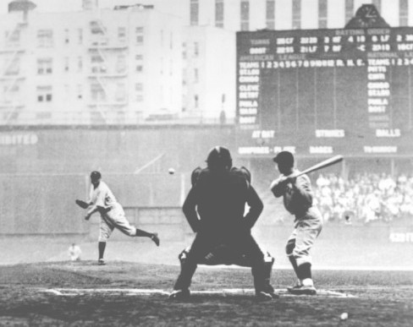
Statistics Before Data Analytics
Bare basics recorded using paper
Stored in file cabinets
Seen by fans in newspapers
Only major stats
HR
AVG
ERA
IP
H
SB
Reliance on gut feelings

Slide 3
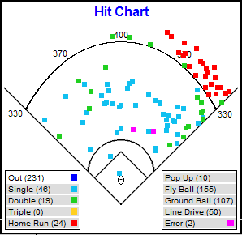
Rise of Data Analytics
Spray charts
Fielding shifts
Less bunting
More strikeouts
More Home Runs
More relief pitching

Slide 4
Need for Another Statistic
All the data available on any player is being used to negotiate trades, contracts and playing time
New statistics have been introduced occasionally since the early 2000’s and players and fans have welcomed them
WHIP
Exit Velo
SLG
OPS

Slide 5

Pitcher Accuracy Metric
Distance a pitcher misses his target by in inches
Data will be recorded and used to determine a PAM
The lower a pitchers PAM, the more accurate he is
The more accurate…
The more successful…
The more games won...
The more he’s paid…
Literally!

Slide 6
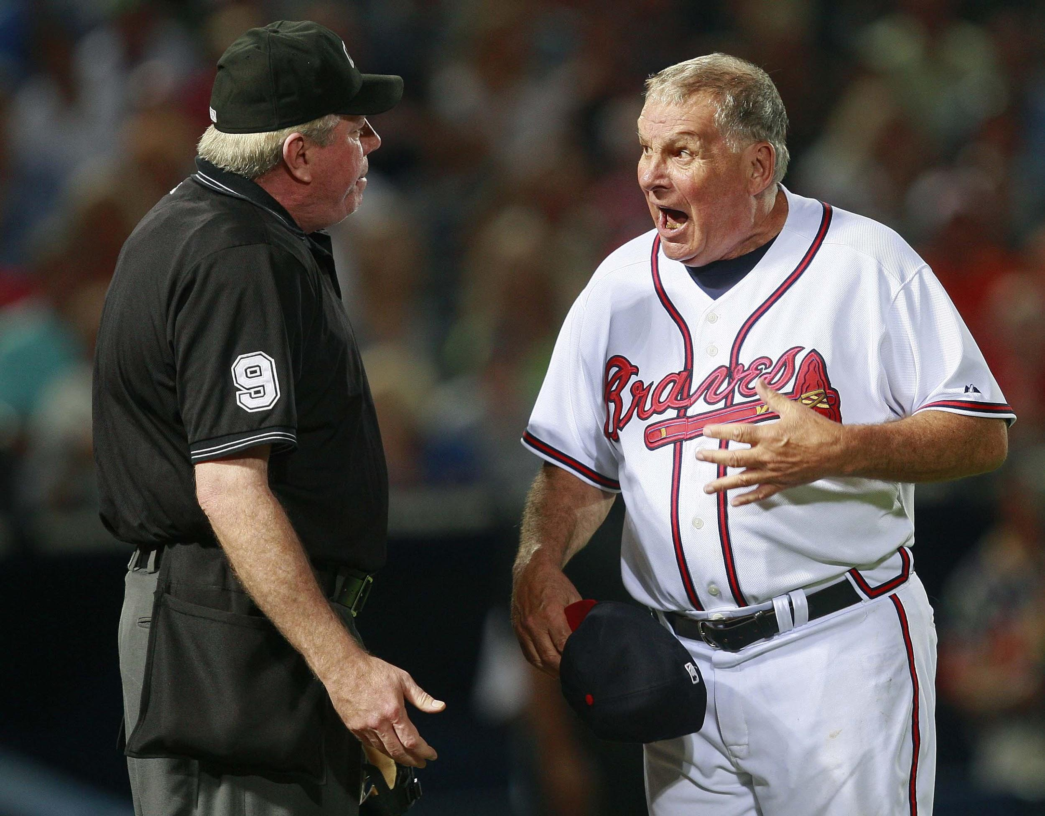
Why Should We Care?
Managers and Owners negotiating player contracts
Assigning pitching rotations
Starter vs Bullpen

Slide 7
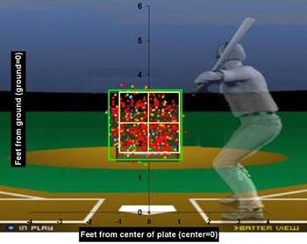
Stakeholders
Pitchers
Hitters
Managers
Owners
Fans

Slide 8
Instrumentation and Measurement
Uncertainty of data
Combine uncertainty
Data is generalized in the beginning
The measurement will be reference from where the pitch land inside the k-zone (or outside it) and the distance from the catcher’s glove
Essentially it measures the distance between the starting position of the glove and the end location where the ball was caught

Slide 9
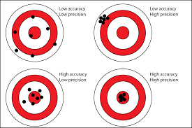
Accuracy and Precision
The K-zone exemplifies both accuracy and precision
Accuracy would be hitting the pitcher’s glove
Precision is hitting the same area in the k-zone or pitchers glove each time

Slide 10

Fund Our Project

